Slide 1

SNC1D0

Slide 2
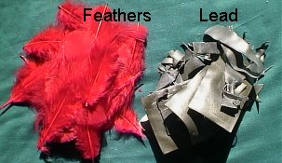
Question
Which is heavier: a kilogram of feathers or a kilogram of lead?
They both have the same mass, but very different volumes!
1 kg of feathers would cover your desk with a 4.5 cm thick layer of feathers
1 kg of lead would only be the size of a cube measuring 4.5 cm x 4.5 cm x 4.5 cm
They have very different densities!

Slide 3
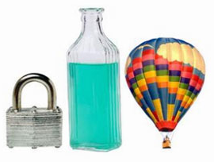
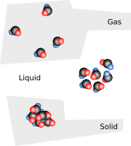

Slide 4
What is density?
Recall: Mass (g, kg) is the amount of matter an object has, volume (l, ml, cm³, m³) is the amount of space an object takes up
Density is the amount of matter per unit volume of matter
Expressed as a formula:
Density (D) = Mass (m)
Volume (V)
m
D
V

Slide 5
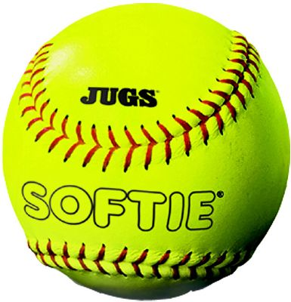
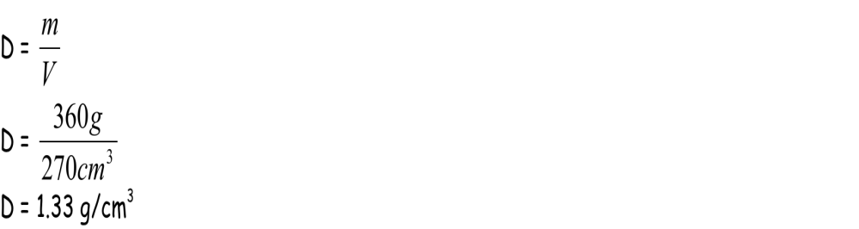
Example 1
A softball has a mass of 360g and a volume of 270 cm³. Find the density.
Given:
    Mass, m = 360 g
    Volume, V = 270 cm³
Required:
    Density (D) = ?
Analysis:
    D = m
    V
Solve:
Paraphrase: The density of the softball is 1.33 g/cm³.

Slide 6
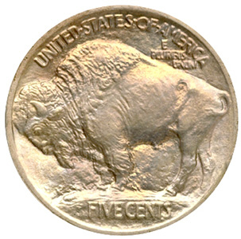
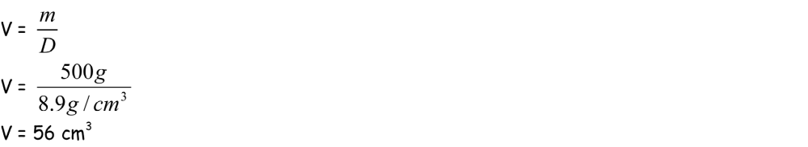
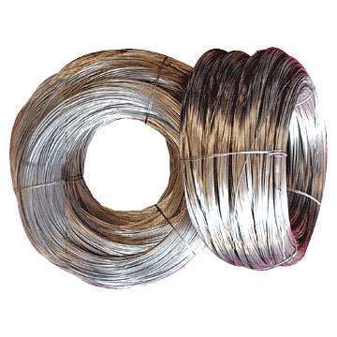
Example 2
The density of nickel is 8.9 g/cm³. What is the volume of 500 g of nickel?
Given:
    D = 8.9 g/cm³
    m = 500 g
Required:
    V = ?
Analysis:
    V = m
    D
Solve:
Paraphrase: A 500 g sample of nickel has a volume of 56 cm³.

Slide 7
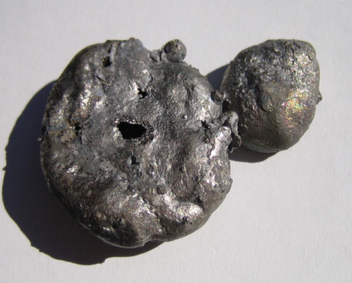
Example 3
What is the mass, in kilograms, of a 1.0 m³ block of iron? Note: Iron has a density of 7.9g/cm³.
Given:
    D = 7.9 g/cm³
    V = 1.0 m³
Required:
    m = ? (in Kg)
Analysis:
    m = DV
    Note: Units do not match!
    Convert volume from m³ to cm³. This allows you to calculate the mass in grams.

Slide 8
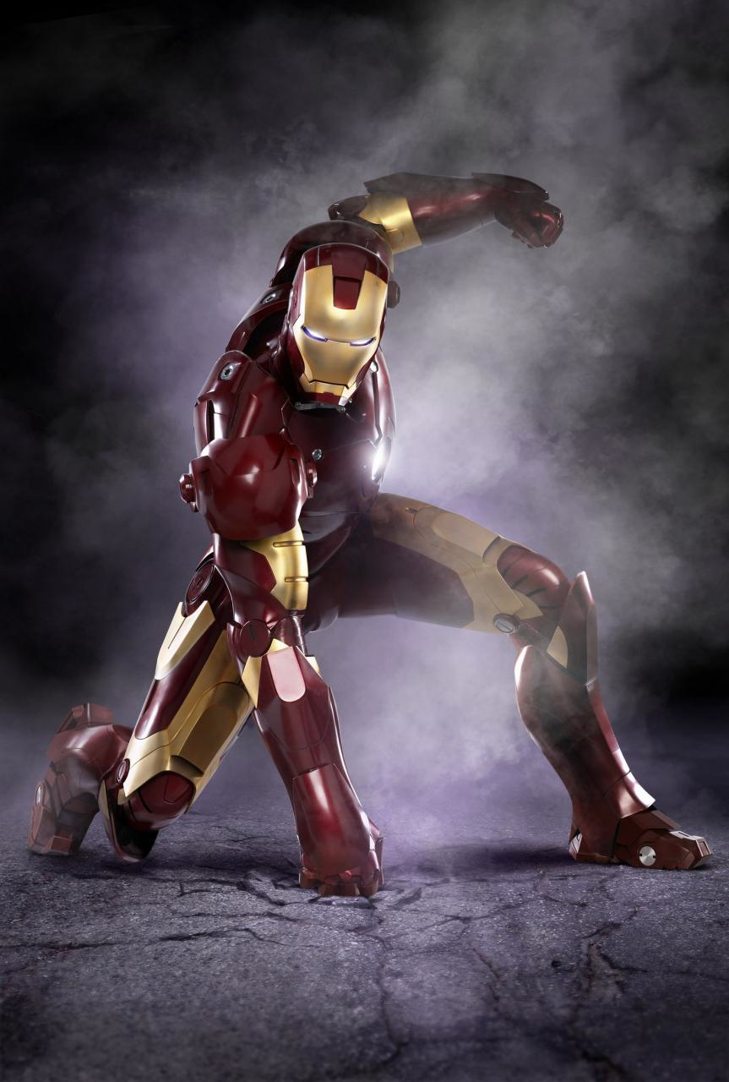
Example 3 Con’t
Solve:
  Conversion of volume from m³ to cm³
    1 m³ rewritten as 1 m x 1 m x 1m
    1 m = 100 cm
    1 m³ can be rewritten as 100 cm x 100 cm x 100 cm or 1 000 000 cm³.
  Calculation of mass
    m = DV
    = 7,9 g/cm³ x 1 000 000 cm³
    = 7 900 000 g
    = 7 900 kg
Paraphrase: The mass of 1.0 m³ of iron is 7900 kg.

Slide 9
Finding density
As long as you can determine the volume and mass of an object, you can determine its density
What are some ways to determine the mass of an object?
What are some ways to determine the volume of an object?

Slide 10
Density of a regular shape object
With a regular shape object, you can use a ruler to measure its dimensions and calculate its density
The volume of a cube or rectangular object is measured by:
Volume (V) = length (l) x width (w) x height (h)

Slide 11
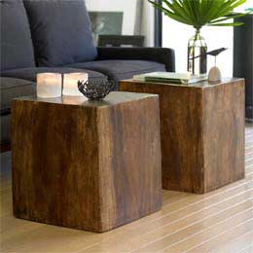
Density of a regular shape object
If you have a 2 cm x 2 cm x 5 cm piece of cedar wood, and it has a mass of 7.4 g, what is the density of cedar wood?

Slide 12
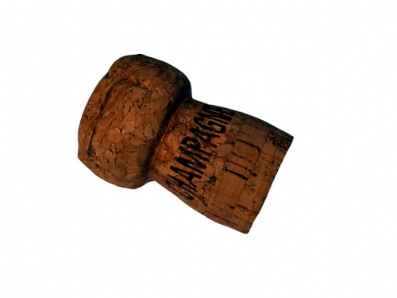
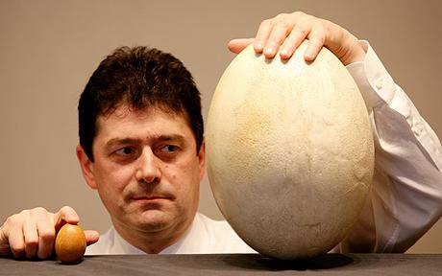
Density of an irregular shape object
There are times when you cannot use a ruler to measure out the dimensions of an object
Water displacement can be used to determine the volume of most solid objects
Find the difference between the initial volume of water in a container, and the volume of the water once the object has been submerged in the container
Notes:
http://www.telegraph.co.uk/news/newstopics/howaboutthat/5049212/Worlds-largest-egg-could-make-100-omelettes.html

Slide 13
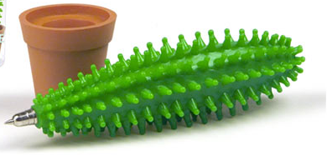
Density of an irregular shape object
What is the density of Mr. Chan’s pen?

Slide 14
Density of a liquid
When calculating the density of a liquid, a container is required to hold it when measuring volume and mass
Volume can be read directly off the container
Mass can be calculated by subtracting the weight of the container from the total weight of the liquid and the container

Slide 15
Density of a liquid
What is the density of water?

Slide 16
Density of a gas
The density of gases is difficult to measure with just a scale and container
Requires taking into account temperature and pressure
Usually calculated mathematically, but that’s something you learn in Grade 11 Chemistry, so we won’t worry about it now!

Slide 17
Recall the following...
When an object is less dense than another, it will float on top of it
When an object is more dense than another, it will sink to the bottom of it
How is it then, that steel boats and oil tankers can float on top of our oceans of water, given that steel is denser than water?

